Slide 1
Hutterthal CHURCH ShaLom Readers 2020
Ages 4 and Up

Slide 2
Requirements
Children read 7 books.
Children create 2 projects based on the books they’ve read.
Once the requirements are completed the children earn a book of their choice.

Slide 3
McKoen
One Smile
I liked this book because it is about making people feel better. Smiling at one person can change everything for them. Then they can make things better for other people.

Slide 4
McKoen
McKoen liked this book because it was about two sisters. She liked the kind sister best. The kind sister was nice to everyone even the snake. When the king needed a wife, he chooses her because she had been nice to the snake (he had been the snake).

Slide 5
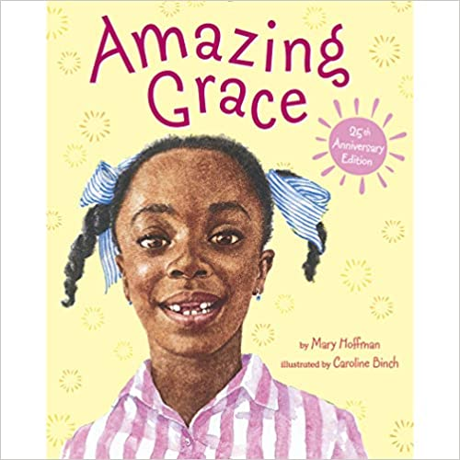
McKoen
McKoen chose the book

Slide 6
Isaac
Faith the Cow
The book is about the Heifer Project.

Slide 7
Isaac
One Smile
The book is about how one little girl smiled at a man that was sad and it made him feel better. He then helped someone and made them feel better. Then those people were happy. They made someone else happy, and t just kept going through the whole town.

Slide 8
Egan
Book: Faith the Cow

Slide 9
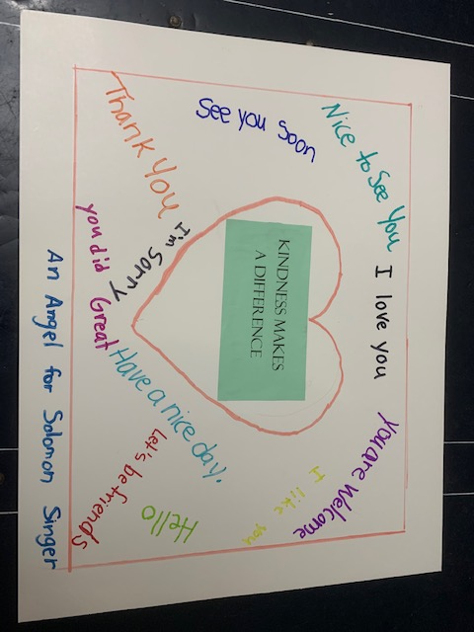
Egan

Slide 10
Egan and Isaac
Together, Egan and Isaac donated to the Heifer Project, Heifer International. Below are the notes from Heifer International and from Egan and Isaac.
This gift is pretty super.
It’s a gift to Heifer International in your name, and it’s going to help other kids around the world. Because of you, children will be able to eat three healthy meals a day, go to school, and play games with their friends. That makes you a superhero, too!

Slide 11
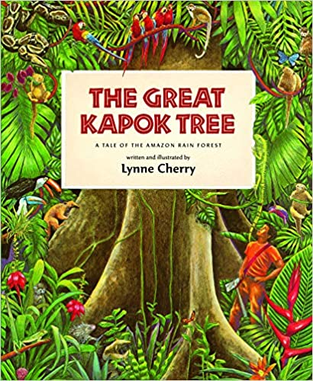
Isaac
Isaac chose the book

Slide 12
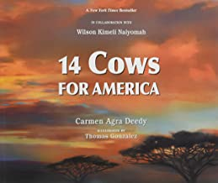
Egan
Egan chose the book

Slide 13
Bridget
Old Turtle

Slide 14
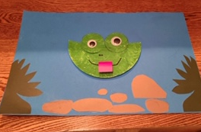
Bridget
It’s Mine!

Slide 15
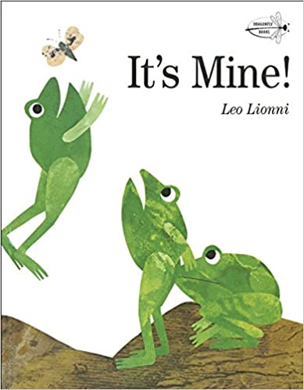
Bridget
Bridget chose the book

Slide 16
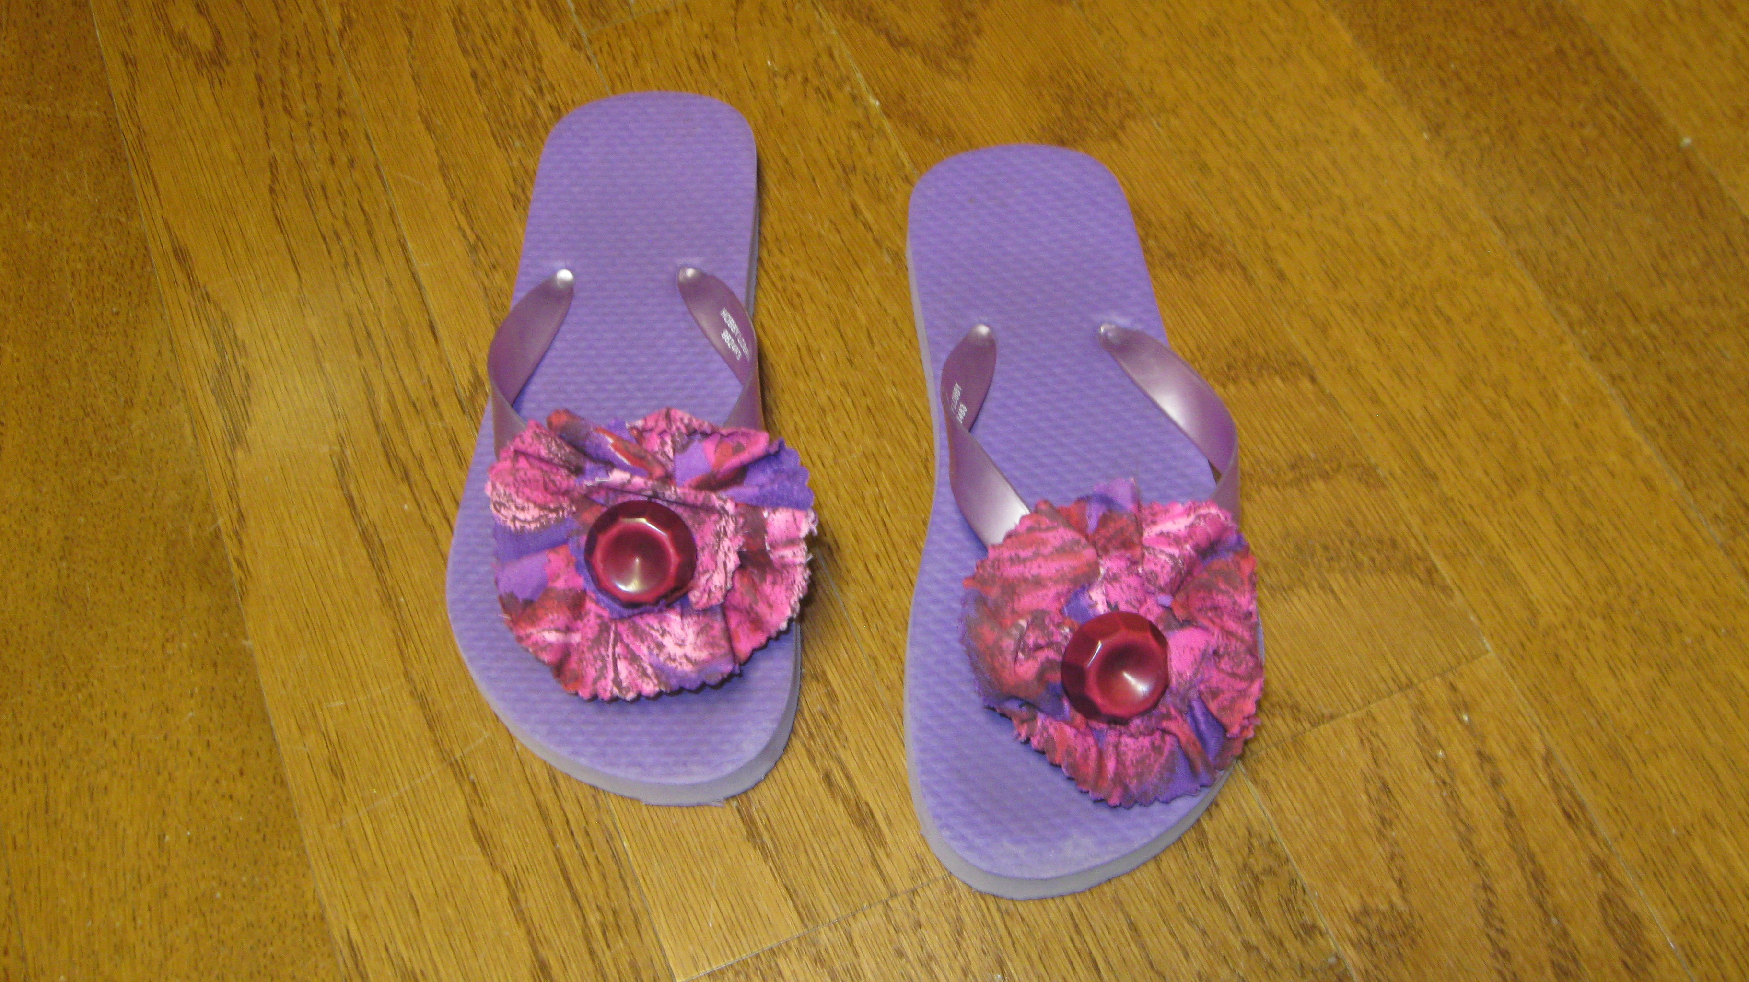
Finley
Four Feet, Two Sandals This is a book about two girls in a refugee camp in Pakistan. When the relief workers throw out used clothing for the refugees to have, Lina finds one sandal that fits her just perfect. When she looks up, she sees another girl with the other matching sandal. What will they do? Who gets to have the sandals? They decide to share and take turns wearing the sandals.

Slide 17
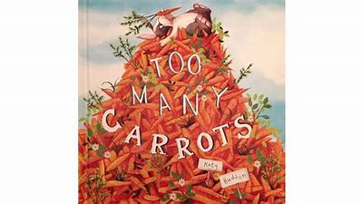
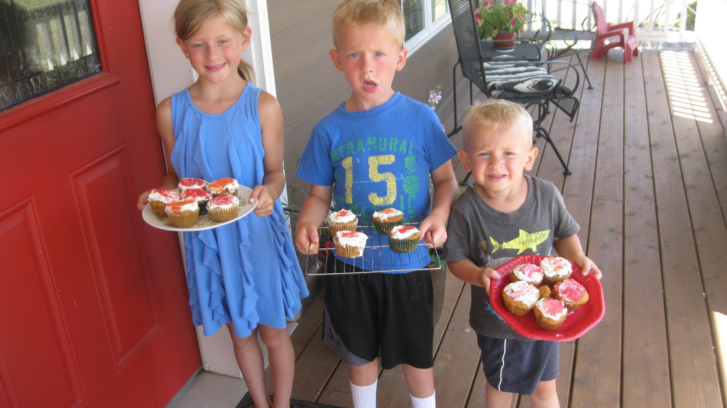
Finley
Finley and Henry made carrot muffins with their grandma and delivered them to several of her neighbors, following Rabbit’s advice that “carrots are for sharing!”

Slide 18
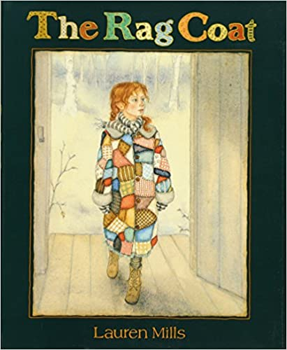
Finley
Finley chose the book

Slide 19
Henry
Do Unto Otters

Slide 20
Henry
Finley and Henry made carrot muffins with their grandma and delivered them to several of her neighbors, following Rabbit’s advice that “carrots are for sharing!”

Slide 21
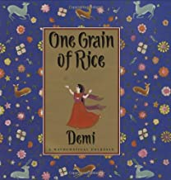
Henry
Henry chose the book

Slide 22
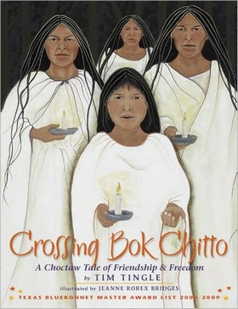
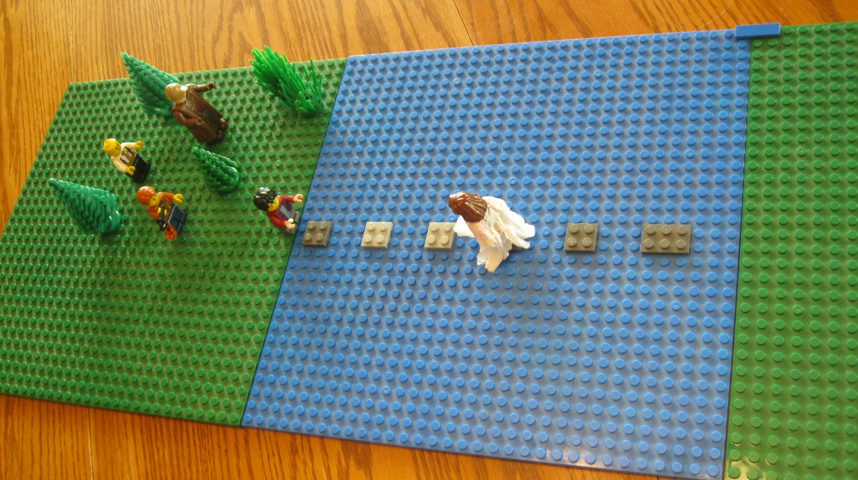
Sam
Crossing Bok Chitto by Jim Tingle.
It is a story of friends and bravery. The story takes place in Mississippi where a river called Bok Chitto was the boundary between the Choctaws and the plantations and the slaves. If a slave escaped across the river, Bok Chitto, he was free. Martha Tom is a Choctaw girl who becomes friends with Little Mo, a slave boy, and helps his family escape to freedom. Here she is helping him get across the river, stepping on certain river stones, as she helps him escape from the men trying to capture him.

Slide 23
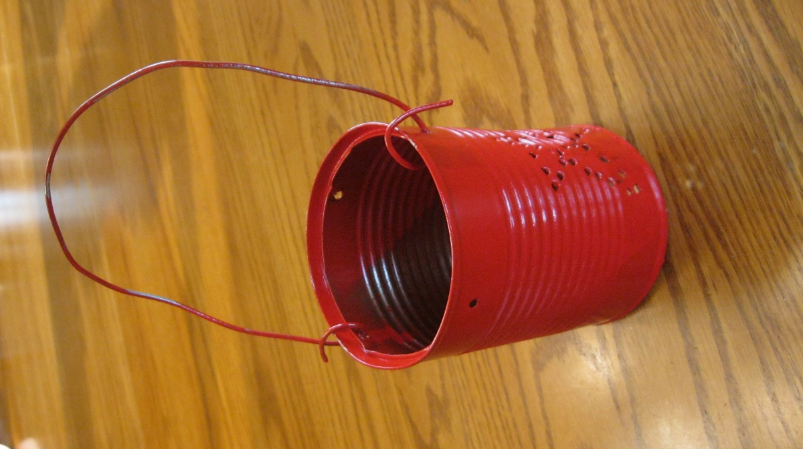
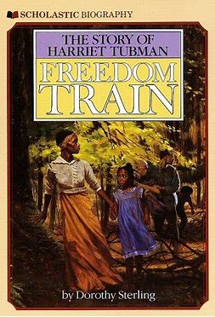
Sam
Freedom Train is the story of Harriet Tubman and her escape from slavery on the Underground Railroad. She also helped many other slaves escape. I made a red punched tin can lantern because she always carried a lantern to help guide her way.

Slide 24
Sam
Sam chose the book

Slide 25
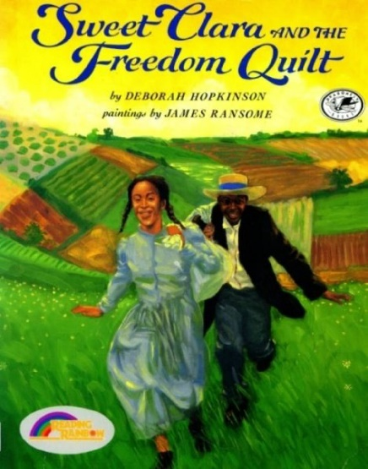
Noelle
Sweet Clara & the Freedom Quilt
Quilt patterns were used as signals to slaves to indicate when to go or where to go as they journeyed on the Underground Railroad.
Flying Geese - instructed runaways to follow the migrating geese north in the spring
Monkey Wrench – alerted slaves to gather tools and supplies for their escape
Shoofly – refers to the conductors who guided slaves north
Crossroads – directed escaping slaves to travel to Cleveland, Ohio. The major crossroad to Canada.

Slide 26
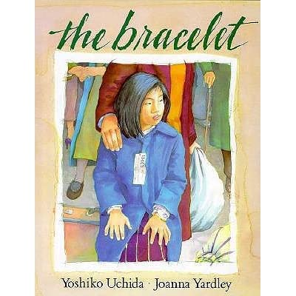
Emi is sent with her family to a Japanese internment camp during WW II here in the United States. A bracelet from her best friend is the only reminder of their friendship. It is a sad story because she loses the bracelet. But her Mom tells her she will always have the memories of her friend and she cannot lose those memories.
Noelle

Slide 27
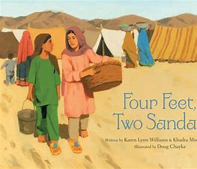
Noelle
Noelle chose the book

Slide 28
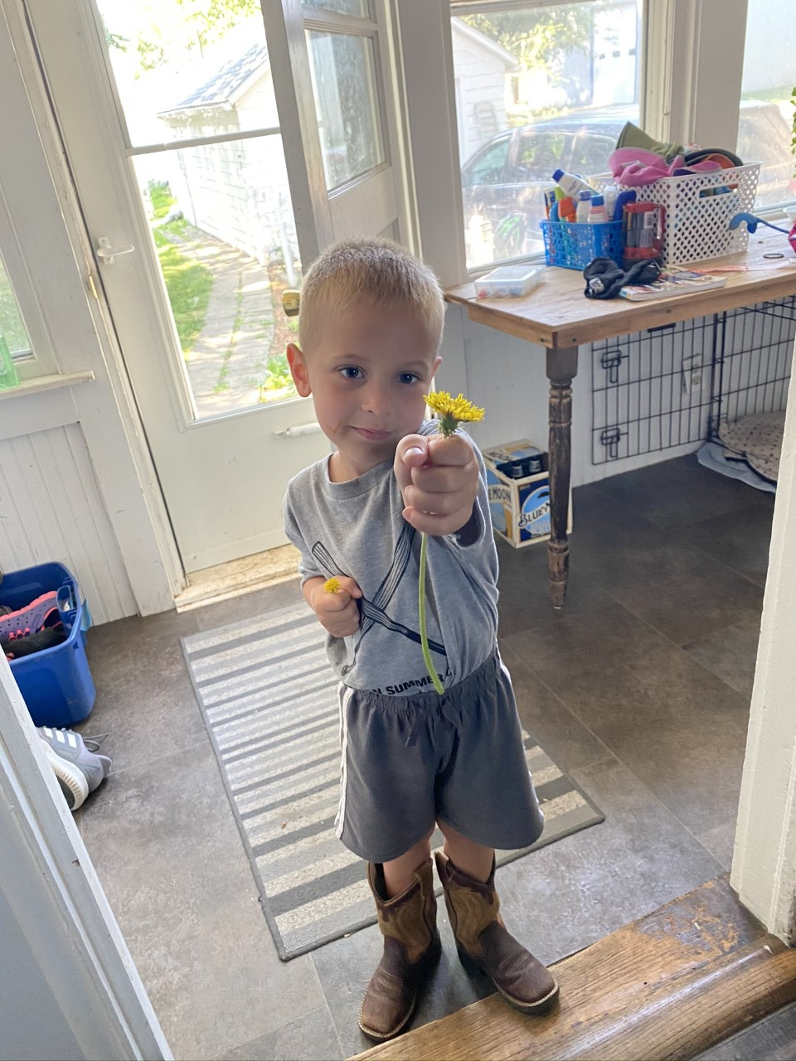
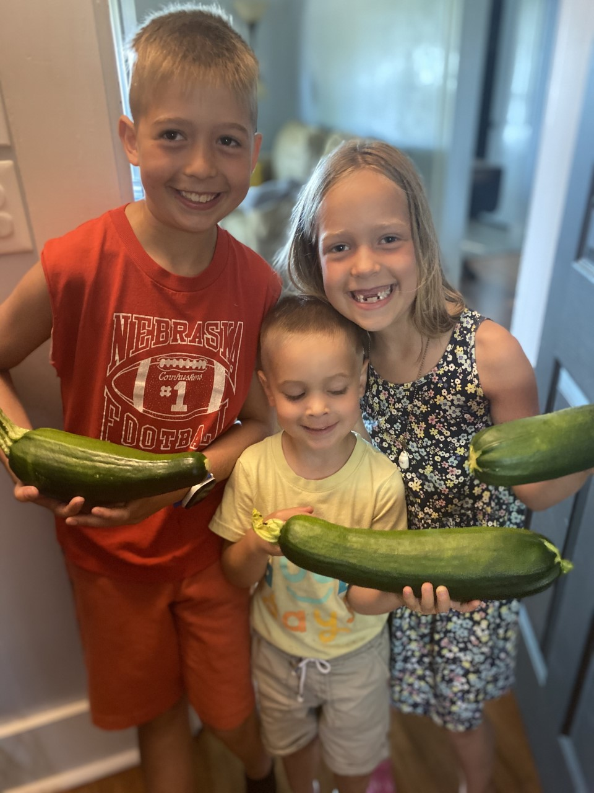
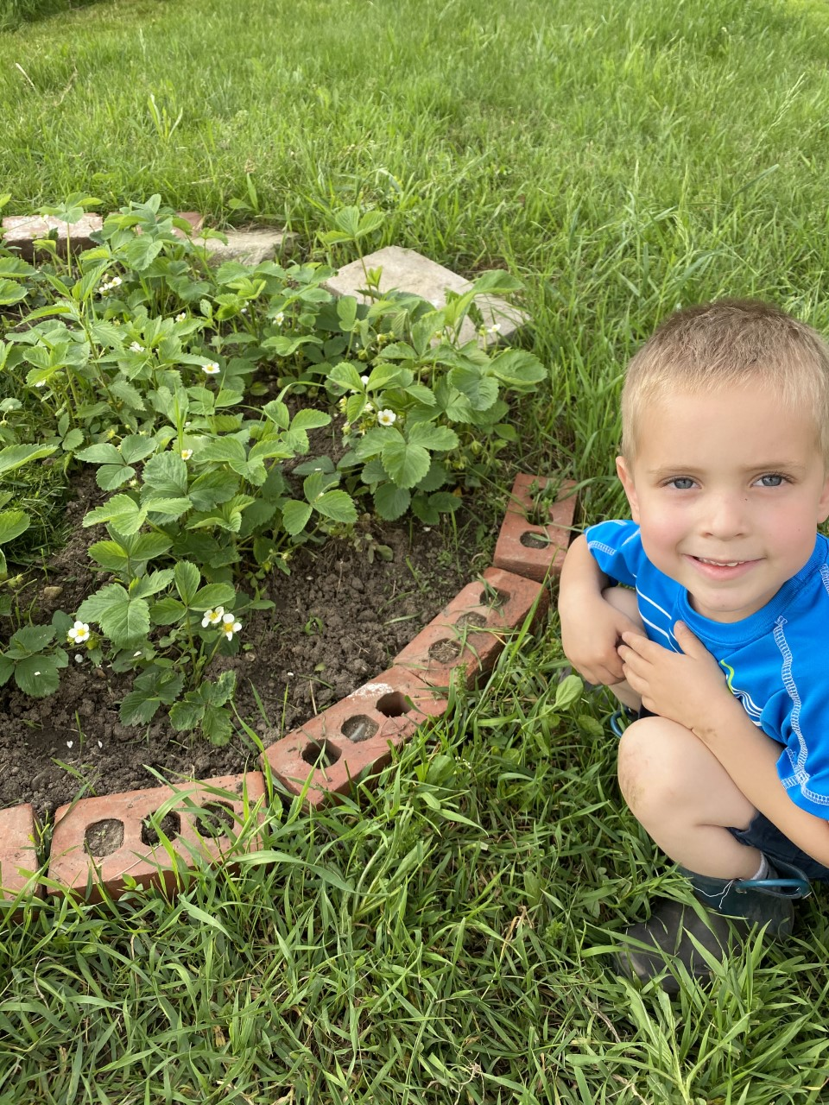
Callum
First Strawberries

Slide 29
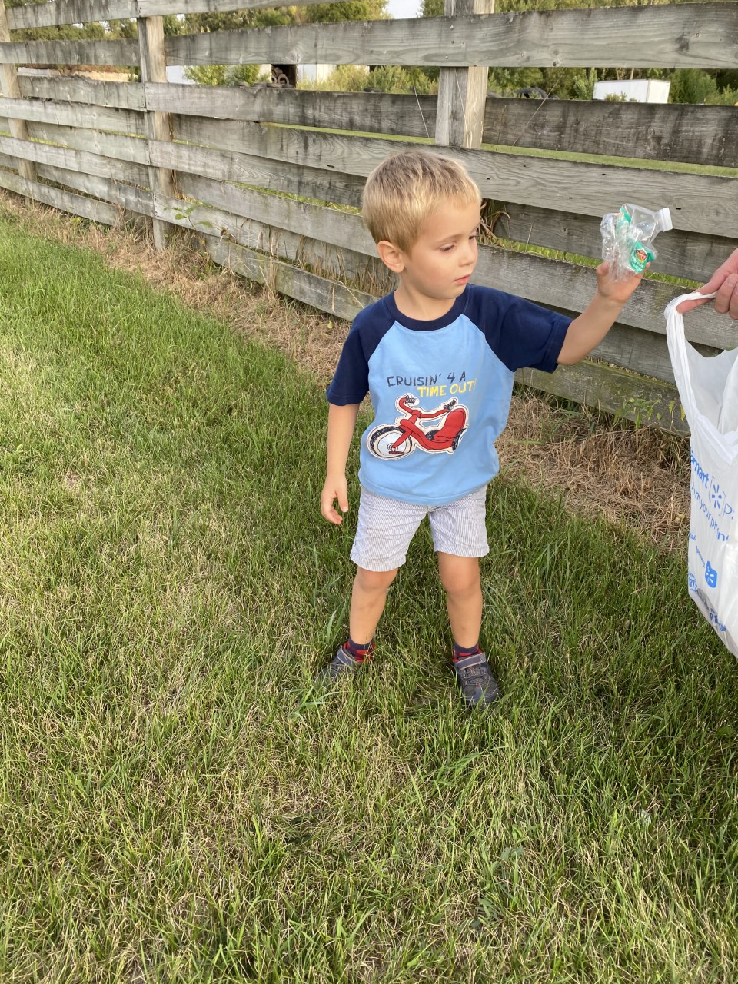
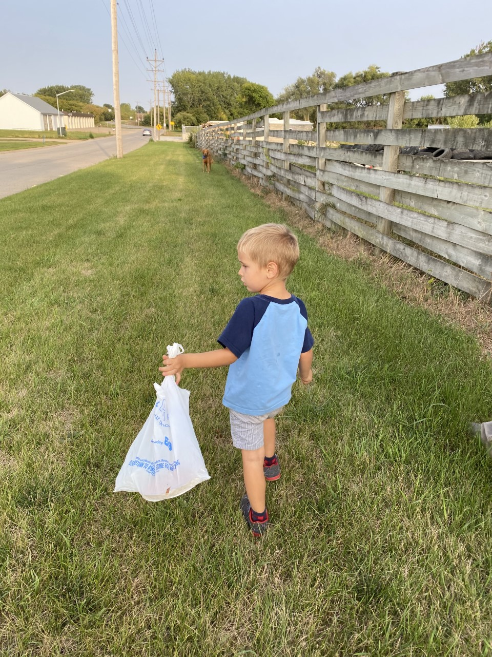
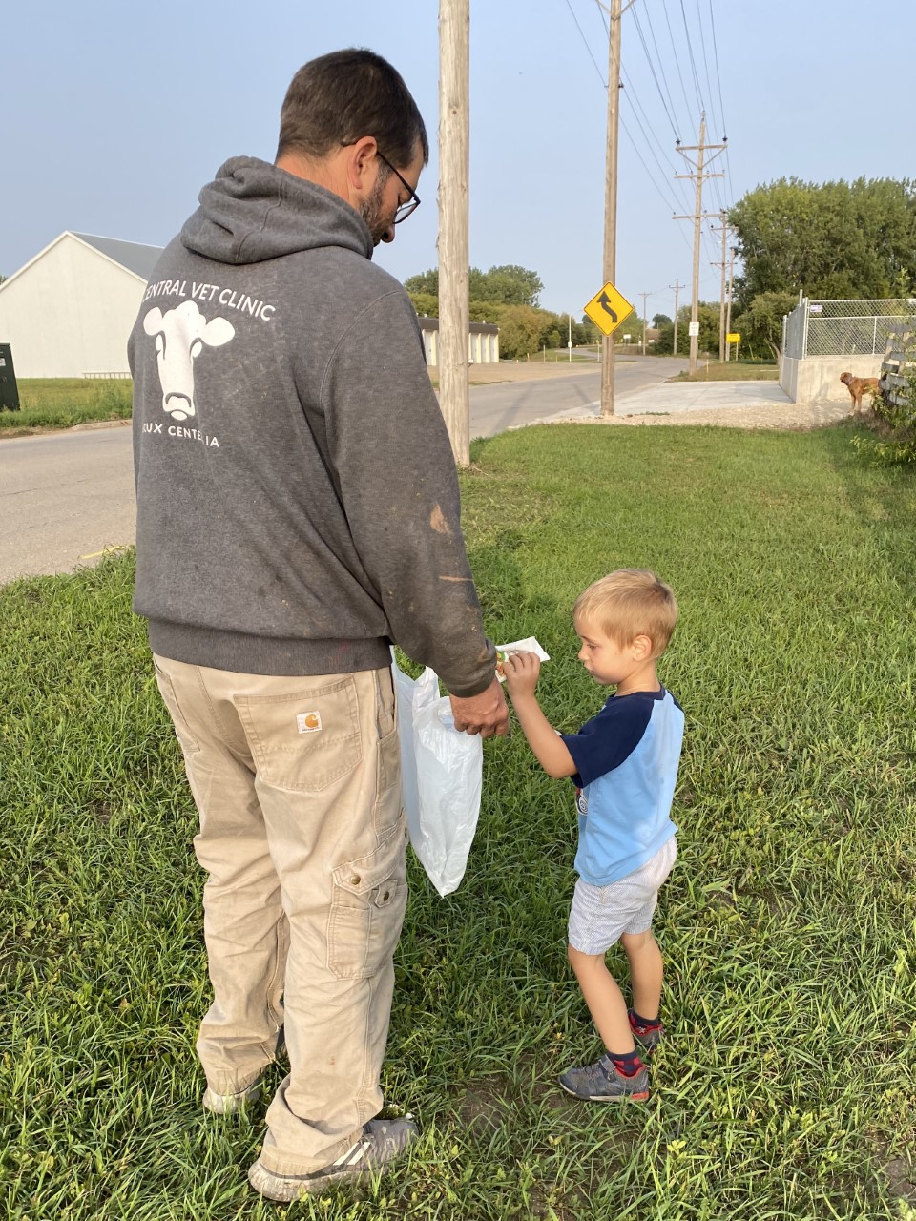
Just a Dream
Picking up trash along the side of the road.
Callum

Slide 30
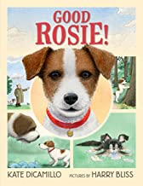
Callum
Callum chose the book

Slide 31
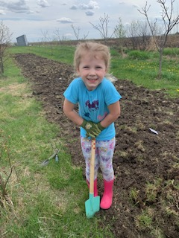
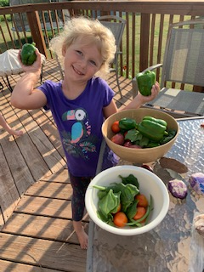
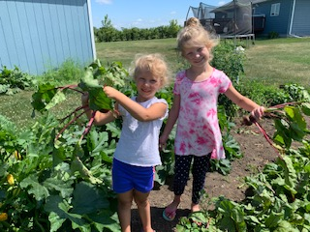
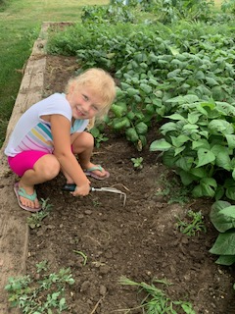
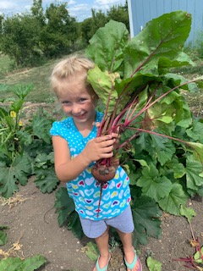
Brynlee
If You Plant a Seed by Kadir Nelson
Brynlee helped plant, grow, and harvest the family garden.

Slide 32
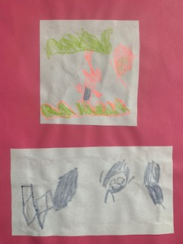
Brynlee
The Crayon Box That Talked by Shane Derolf
Brynlee made a handprint crayon box.
The Peace Book by Todd Parr
Peace is playing with my sister.
Peace is helping Mom clean.

Slide 33
Brynlee
Brynlee chose the book

Slide 34
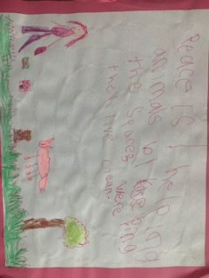
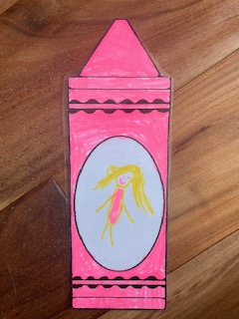
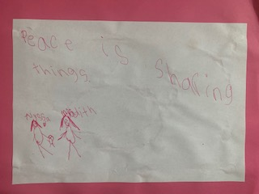
Alyssa
The Peace Book by Todd Parr
Peace is sharing.
Peace is helping animals by keeping the space where they live clean.
The Crayon Box That Talked
by Shane Derolf
Alyssa made a handprint crayon box ad drew a picture of herself inside a crayon colored in her favorite color.

Slide 35
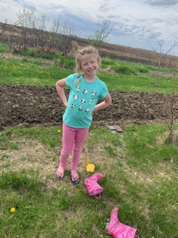
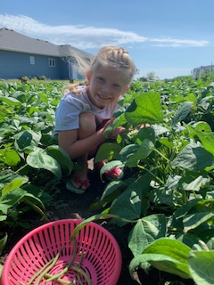
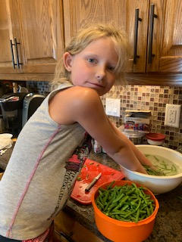
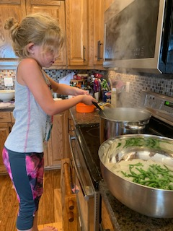
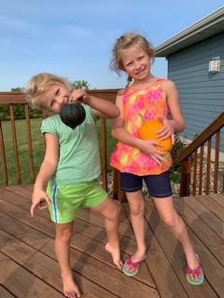
Alyssa
If You Plant a Seed by Kadir Nelson
The Curious Garden by Peter Brown
Alyssa helped plant, grow, harvest, freeze the produce from the family garden.

Slide 36
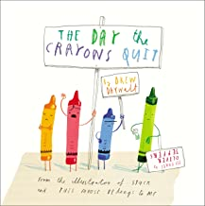
Alyssa
Alyssa chose the book

Slide 37
